Slide 1
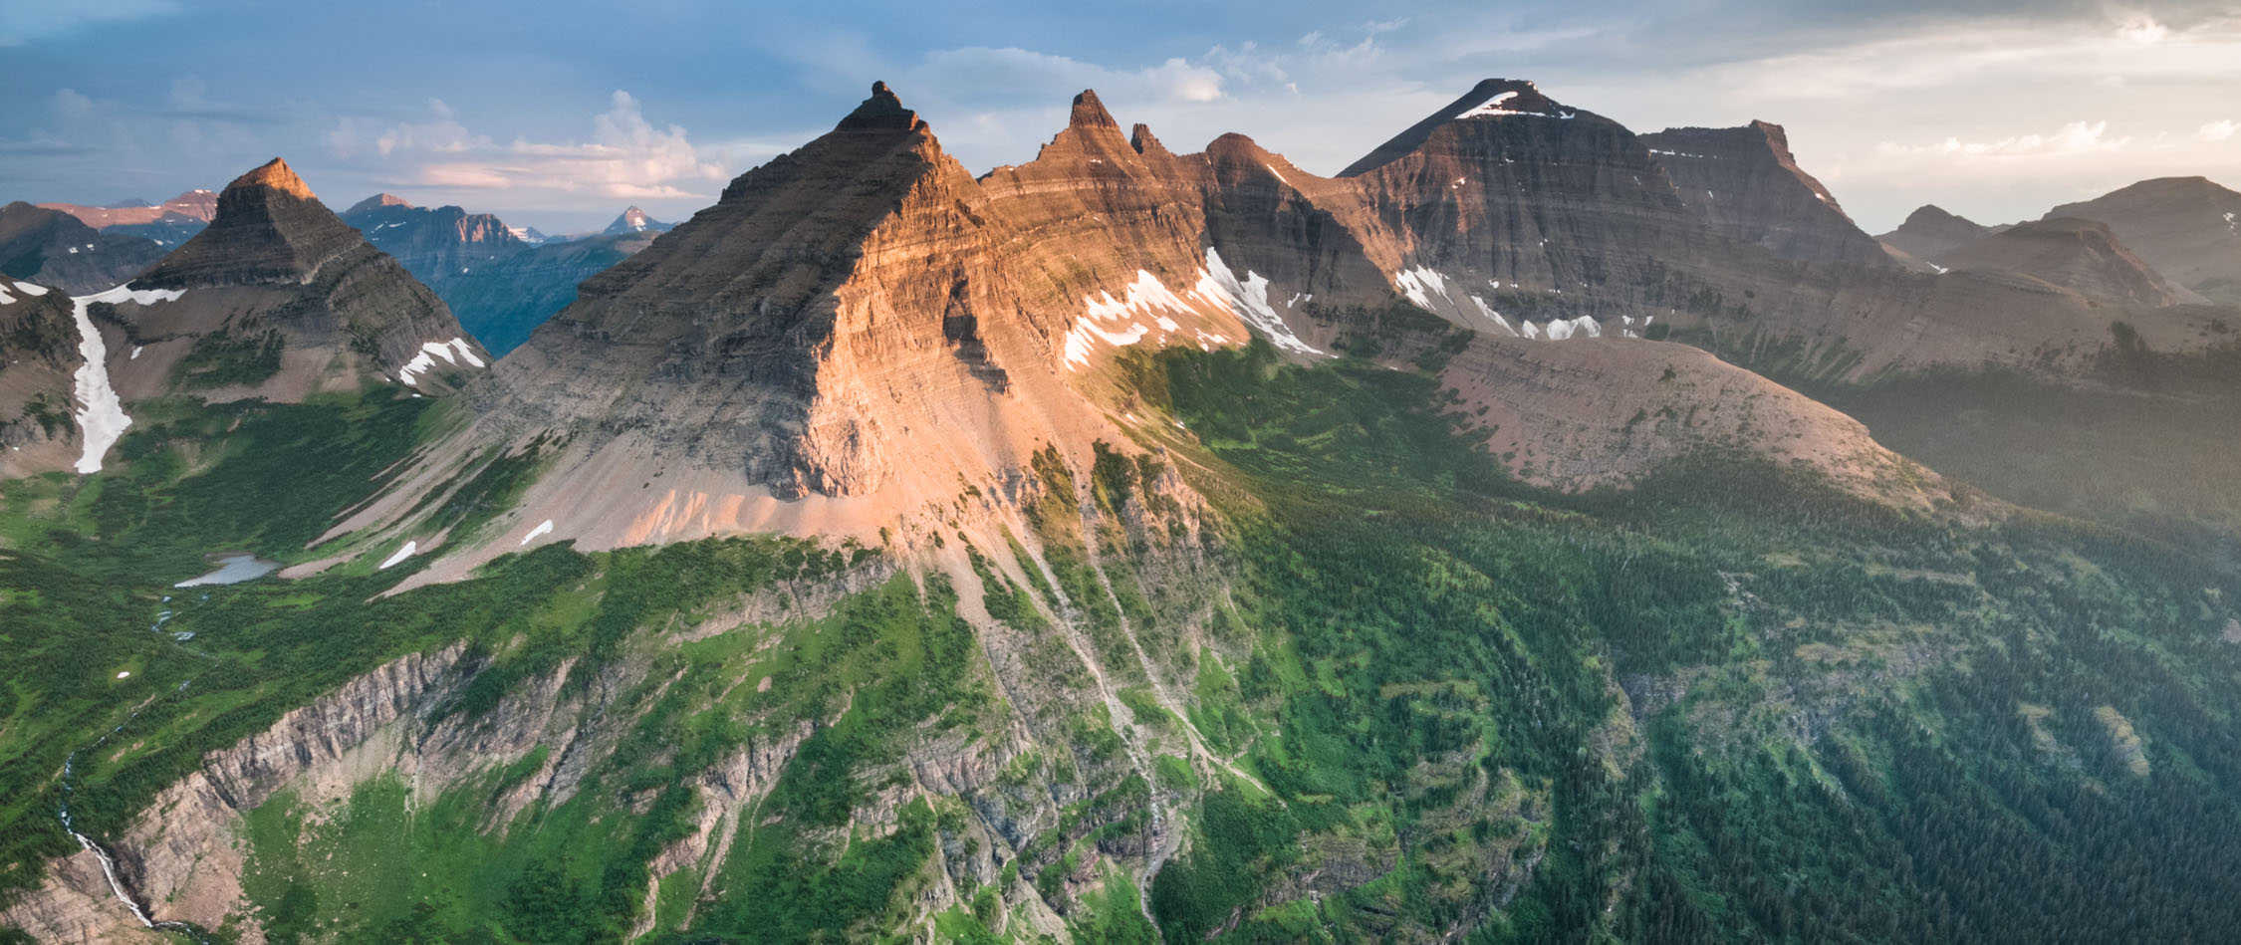
Storylines and LOCA updates
Joe Hamman¹, Ethan Gutmann¹
NCAR Research Applications Lab
Photo: Steven Gnam
NCAR - Reclamation - USACE Project Update Meeting
Aug 28-29, 2018

Slide 2
Outline
LOCA project
Project overview
Synthesis of meteorology dataset
Synthesis of hydrology dataset
Storylines connections
Slide on logistical issues
Storylines Project
Project overview
Related downscaling components
Tool development (chains)
New results
Next steps

Slide 3
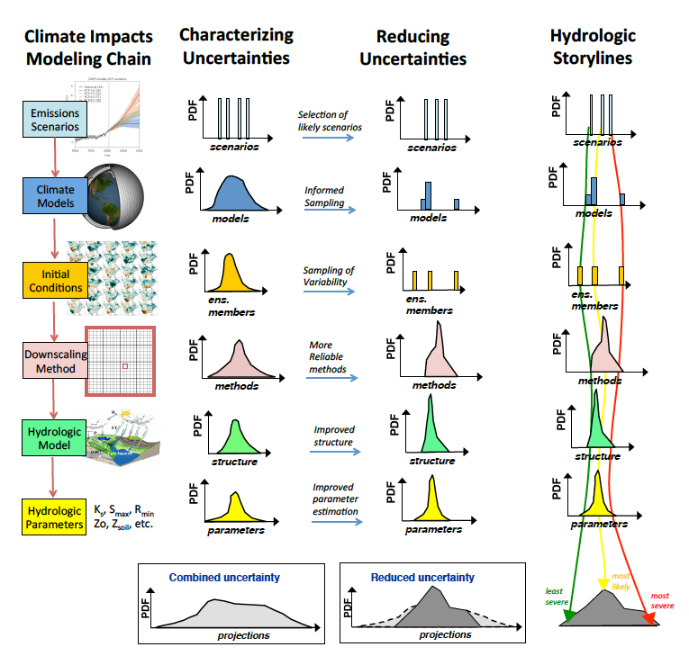
Characterizing and Reducing Uncertainty
Hydrologic Storylines
Typical modeling chain for understanding hydrologic changes due to climate change includes many steps
Significant gaps in understanding sources and relative contributions of uncertainty in final projections
Characterizing these uncertainties is the important first step in reducing uncertainty
Reducing uncertainty centers around choosing more reliable projections / methods
Need to formalize approaches for selecting a discrete set of ensemble members
Figure: Clark et al, 2016

Slide 4
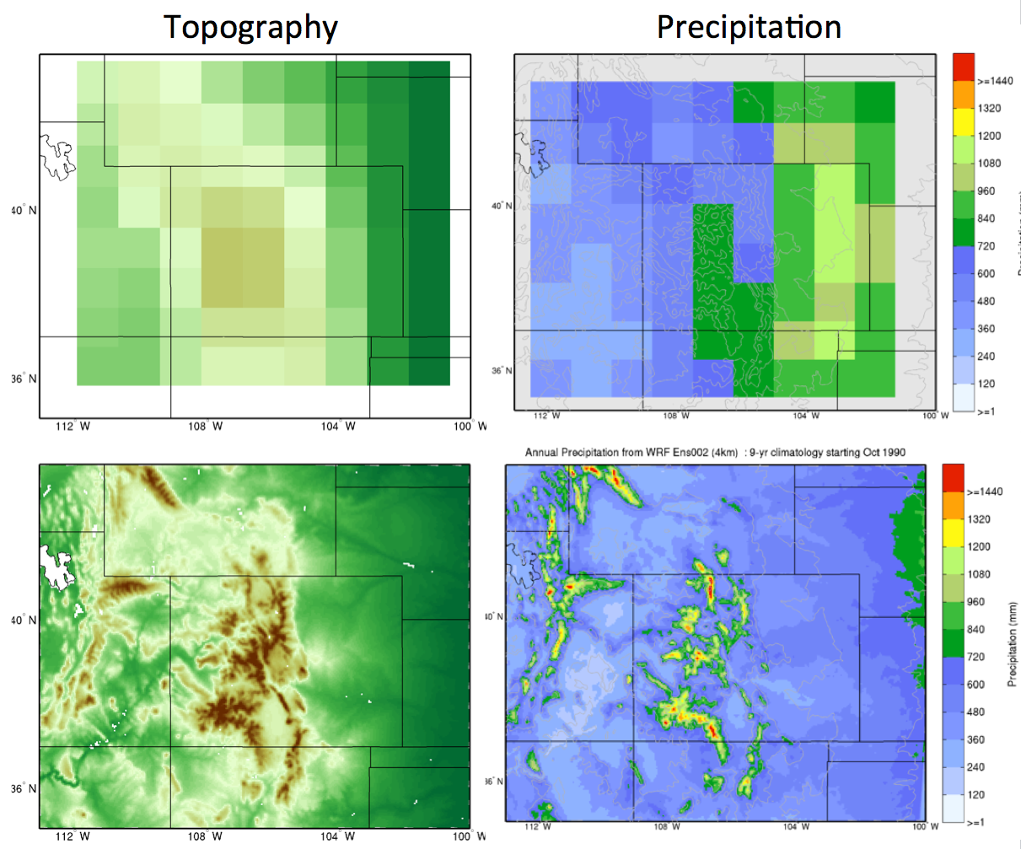
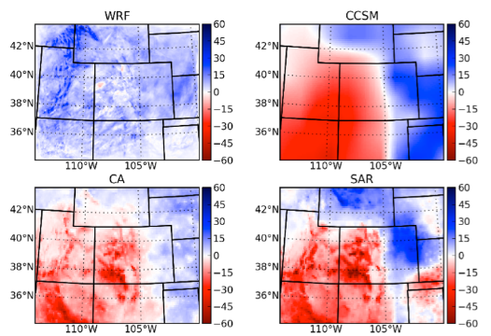
Rescaling GCM in topographically complex regions
Common methods only use GCM precipitation
Precipitation is not well represented in GCMs (particularly in topographically complex regions)
Differences in the sign of the climate change signal
What predictor variables are appropriate for statistical downscaling? Can we use atmos. circulation?
GCM
Precipitation (mm/year)
Change in Precipitation (%)
High-res WRF
Precipitation (mm/year)
Notes:
Some of the most common SD methods only use GCM precipitation
The problem is that GCMs don’t do a very good job at representing the spatial distribution of precipitation. Particularly in topographically complex regions)
Example of a sample GCM putting precipitation east of the Rockies compared to the high-resolution WRF simulation
Typical statistical downscaling methods end up rescaling GCM precipitation.
This leads to change signals that look a lot like the driving GCM but ignore some physical processes (for example how topography may influence how changes in precip are distributed)

Slide 5
Reproducing historical climate is relatively easy
Downscaling methods are frequently post-processed (quantile mapping)
This makes reproducing historical climate easy but what is lost?
Do we understand the implications and limitations of post-processing?
Garbage in, garbage out?
Obs.
NorESM
Historical
Notes:
A comparison of typical statistical downscaling methods may lead one to believe that all these methods do a good job reproducing historical climate.
However, this is actually a pretty low bar when these datasets are post-processed using tools like quantile mapping.
As an example of how easy this is, in the bot. left part of the screen, I’m showing a map of spatially correlated random noise. If I quantile map this dataset I get something that looks sort-of like weather. In fact, if do this for many timesteps, we get a climate that looks just like the training/observation dataset. Of course, this is by construction.
We have to be careful that we aren’t stepping into the garbage in- garbage out problem.

Slide 6
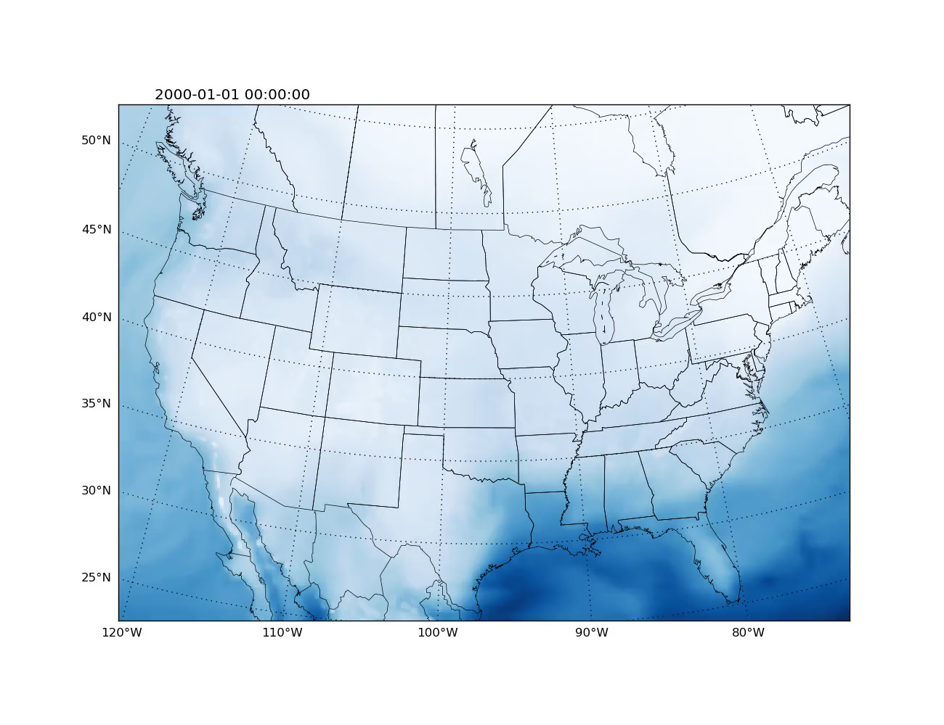
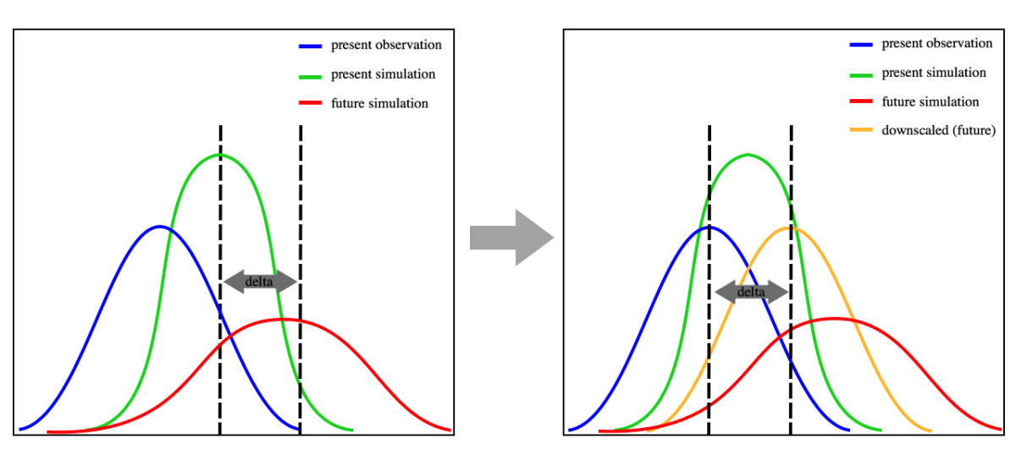
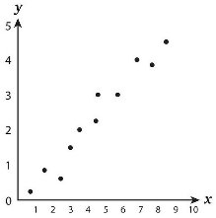
Downscaling Method Complexity
Increasing methodological complexity in downscaling methods
GCM
Raw
(spatial
interpolation)
Delta
Method
BCSD
Linear
Regression
Analog
Analog
Regression
Machine
Learning
Low-res RCM
+ regression
(+ combinations)
ICAR
High-res
RCM
(Multivariate)
Observations
GCM
Tradeoffs:
Physical realism vs. computational cost
Explicit physics/feedbacks vs. simplicity
En-GARD is targeting this space
Notes:
1) Ethan introduced the notion of a “Conceptual Divide in Downscaling” between statistical methods and full physics regional climate models.
2) We’re trying to make the argument that there are actually a spectrum of methods that incrementally add complexity.
3) We’ve been working on developing tools that are efficient enough to be used on large numbers of climate simulations but that include more physical realism
4) Today I’m talking about a new downscaling tool, En-GARD, that targets a complexity space between single variate SD methods and reduced physics GCMs.

Slide 7
En-GARD: Generalized Analog Regression Downscaling
Driving Principles
Use as much useful data as you can
Generalize the problem
Embrace uncertainty
En-GARD Statistical Downscaling
Based on Hay and Clark (2003) – original application in streamflow forecasting
Mimic or combine most common statistical downscaling approaches
Analogs
Regression
Analog + Regression
Quantile-mapping
Ensembles from multiple methodologies and from perturbed errors
Observations
GCM
Notes:
En- GARD stands for Ensemble Generalized Analog Regression Downscaling
Driving principles are…
Basic idea is similar to many other SD tools, develop relationship between GCM (precip) and observed precip. Mix in analog selection techniques.
Possible to build controlled ensembles by constructing multiple methods and/or purtubing the error components on individual regressions.

Slide 8
En-GARD: Generalized Analog Regression Downscaling
Dataset
Analogs
Newman Precipitation
Add “e” back to quantify uncertainty.
Use a stochastic process that maintains spatial-temporal correlation of residuals
Training Data
ERA-I / WRF
Pr, T, U, Qv,…
GCM / WRF
Pr, T, U, Qv,…
X C + e = Y
X = ERAi variables & constant
C = Regression coefficients
e = error term
Y = Observed variable (e.g. precipitation)
Residuals of regression,
Spread in analogs, …
Notes:
This is a schematic demonstrating how some of the key features of GARD work.
Typical SD setup (Obs, training, GCM datasets)
We can then develop a multi-variable regression using the obs and training and use those relationships to downscale the prediction dataset. This process can be generalized such that the analog selection process can select a single analog or use the full timeseries.
The ensemble component of GARD comes in by using the error term in the regression at each timeseries.
Ensembles of projections can be constructed using the mean and a collection of spatio-temporally correlated random fields.

Slide 9
Building a GARD Ensemble Member

Slide 11
Large ensemble of downscaled data
Large ensemble of downscaled meteorological projections over 1/8° CONUS domain
Combines existing methods (BCSD, LOCA, ICAR) with a collection of GARD methods
GARD members use WRF-50km dataset
GARD methods cover a range of predictor variables and downscaling configurations
RCP8.5
GCMs | Historical | RCP 4.5 | RCP 8.5
MIROC5 | x | x | x
CNRM-CM5 | x | x | x
CanESM2 | x | x | x
ACCESS1-3 | x | x | x
CCSM4 | x | x | x
NorESM1-M | x | x | x
MRI-CGCM3 | x | x | x
GISS-E2-H | x | x
GFDL-CM3 | x | x | x
IPSL-CM5A-MR | x | x | x
ERA-Interim | x
Downscaling Methods
BCSD
LOCA
WRF-50km
ICAR
GARD x 12
X
Variables (daily)
Precipitation
Mean Temperature
Diurnal Temperature Range
Key point: Using this dataset, we can explore questions of how and why different change metrics vary between GCMs and downscaling methods.
Notes:
We’ve been developing a large ensemble (~350 members) of downscaled meteorology for use in hydrologic modeling
Combining a range of downscaling products (BCSD, LOCA, ICAR, and a bunch of GARD ensemble members).
The GARD and ICAR members in the results here are driven by the same 50-km WRF dataset
Existing datasets like BCSD and LOCA are taken off the shelf from their respective locations

Slide 12
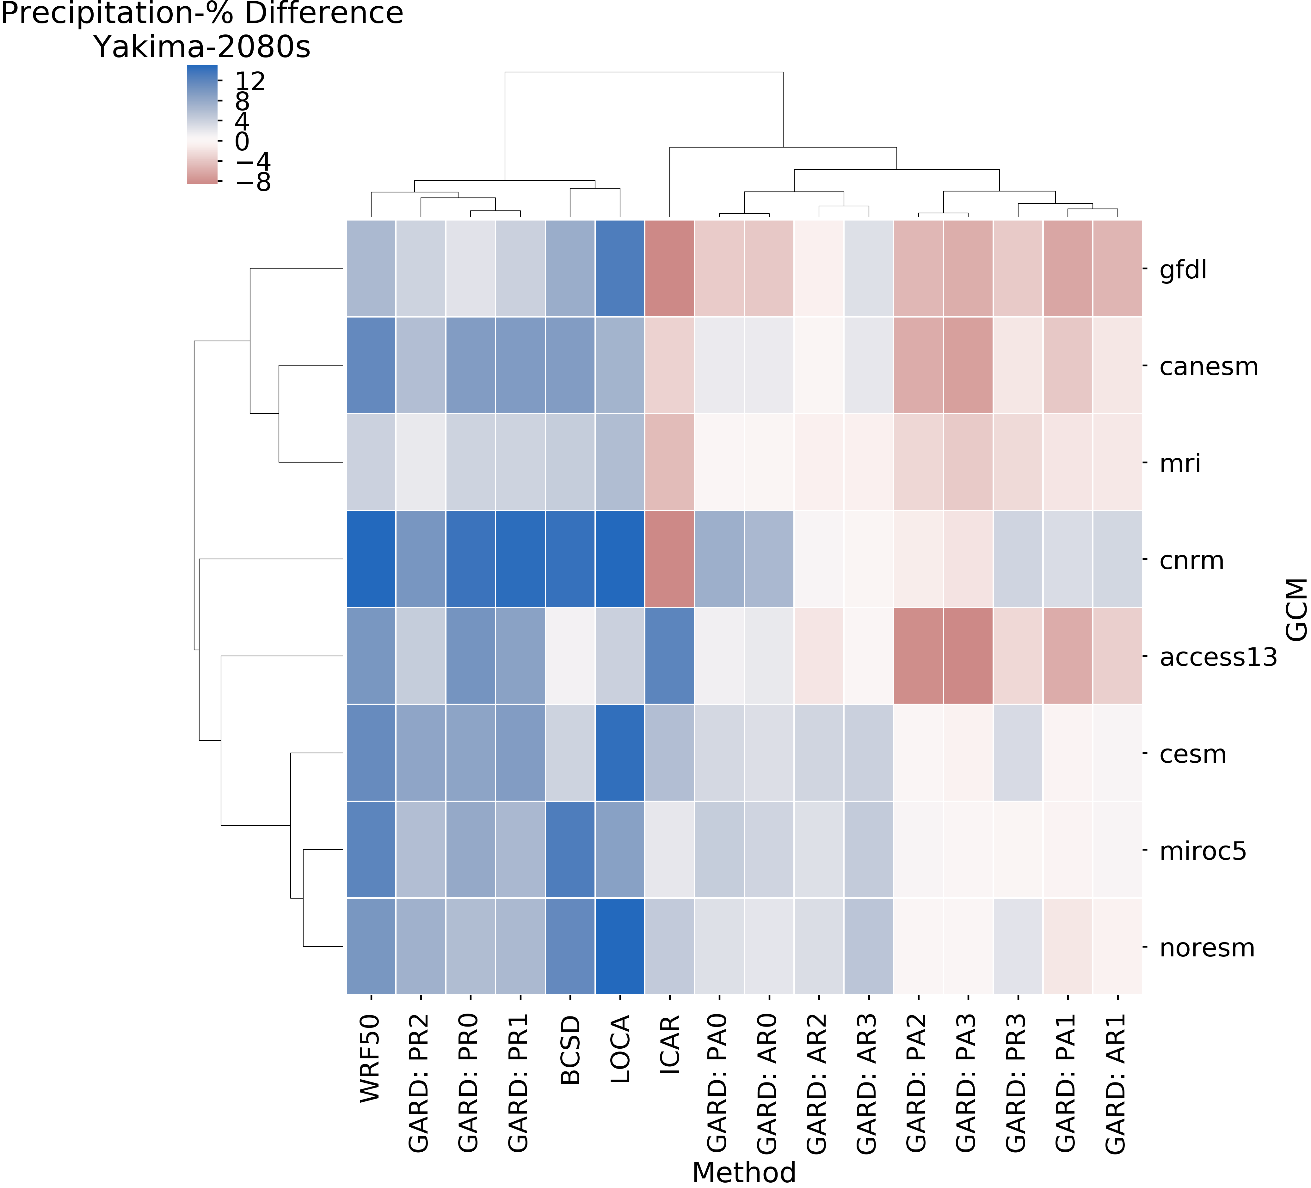
Examining ensemble structure
Change in Precipitation
Yakima River Basin (2080s-1980s)
Obvious Point: Downscaled change signals can vary substantially by both downscaling methods and GCMs.
Key questions:
Why do predicted changes have opposite signs between different downscaling methods?
How closely should we expect downscaled change signals to agree with the change signal from the driving GCMs?
What do we loose when we inforce the GCM signal on the downscaled dataset?
Notes:
I wanted to show a few examples of what we can start to do with this dataset. Disclaimer: we’re just starting to work with the dataset so todays results are just a preview. (Come back next year if you want all the answers)
This is a clustermap. Basically a heat map, showing change in precipitation for the Yakima River Basin in the PNW. The columns and rows have been arranged such that the methods and GCMs are clustered next to others that have like changes.
Take away points. There are some big differences here. +/- 10% of current precipitation. You can find that range along either the GCM or DS axis.
If we isolate along a few GCMs or a few DS methods, we can really see how diverse these change signals can be.
This leaves us with a few questions:…

Slide 13
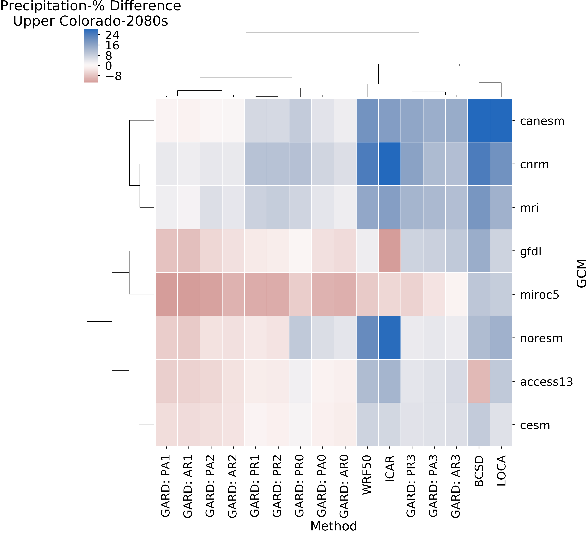
Sensitivity changes by metric and location
Change in Precipitation
Yakima River Basin (2080s-1980s)
Change in Precipitation
Upper Colorado River Basin (2080s-1980s)
Notes:
1) Obviously, I’ve just shown you one basin. We’re looking at many more. Here’s an example from the Colorado as well.
2) Upon inspection, we can see that the relative position and signs have changed for all of these methods.
3) A take away point here is that if we had just looked at BCSD and LOCA, we may have concluded that downscaling methods are not all that important (not all that uncertain)

Slide 14
Nextgen En-GARD
A community platform for Big Data geoscience
As part of the Pangeo effort (https://pangeo.io), I’m building a downscaling package that:
Builds on what we’ve learned from GARD
Adds a easy to use Python interface
Allows for the flexible construction of many more downscaling methods (e.g. Machine learning from Scikit-Learn)
Highly scalable on HPC and cloud computing

Slide 15
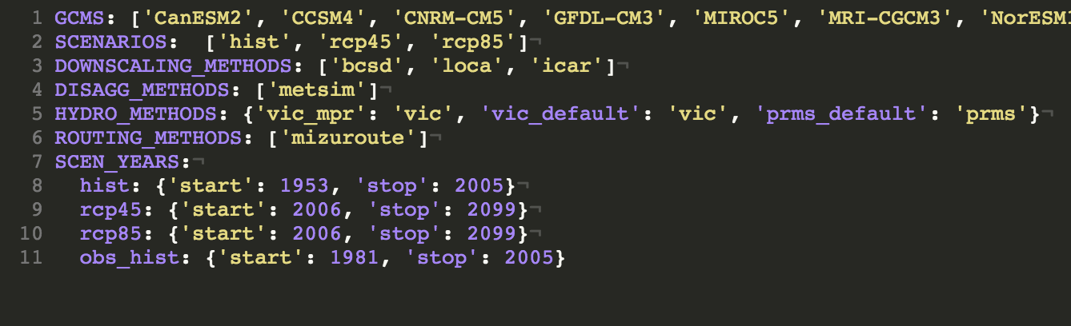
Chain-of-Models Tool Kit
Snakemake workflow management
Rule and dependency based system runs only what it needs to when it needs to
Configured to
Download and pre-process data
Configure and run chain of models
Post-process output from each model component
Modular, portable, extensible
Still adding components
On Github:
https://github.com/jhamman/chains
Promising starting point for possible CMIP6 work
$ snakemake all …
Building DAG of jobs...
Job counts:
count jobs
21054 config_metsim
129 config_prms
258 config_vic
10410 downscaling
1 hydrology_models
21054 run_metsim
129 run_prms
262 run_vic
64139

Slide 16
Research Ensemble
Current effort:
Pushing first set of simulations through
Current data volume (~350 TB)
Started with:
BCSD, LOCA and ICAR
VIC and PRMS
Default and MPR parameters (for VIC)
Will be adding:
GARD, FUSE, SUMMA, Mizuroute
Example directory structure from storylines ensemble
storylines_ensemble
├── ACCESS1-0
├── ACCESS1-3
├── BCC-CSM1-1
… (30 total GCMs)
├── MPI-ESM-MR
├── MRI-CGCM3
├── NorESM1-M
│ ├── hist
│ ├── rcp45
│ └── rcp85
│ ├── bcsd
│ ├── icar
│ └── loca
└── obs
├── livneh
└── newman

Slide 17
Sample results
Common simulation framework
Allows for consistent comparisons between ensemble members
Comparing observed and GCM forced ensemble members
Interesting tidbits from the observation forced runs
*Maurer gridded obs runs ongoing

Slide 18
Sample results

Slide 19
Next steps for the storylines project
Hydrologic Storylines
Continue building out the ensemble:
Short term: Add new rules for SUMMA, FUSE, Mizuroute, etc.
Current ensemble is ~150 members @ 1/8deg over CONUS
Target ensemble size of ~850 ensemble members (including GARD, SUMMA, etc)
Manuscripts in the works:
Write paper characterizing the uncertainties in ”large” ensemble.
Write paper exploring methods for ensemble sampling and model culling.
Promote (or publish) chains workflow
Things we wish we had:
Tools/methods for generating ensembles of model parameters
Infrastructure to create, calibrate, and run large ensembles of SUMMA models
Figure: Clark et al, 2016

Slide 20
LOCA talking points
Dataset format:
We’ve found multiple inconsistencies in netCDF metadata
Dimension / coordinate names
Met and hydro datasets are formatted differ
Early results from storylines ensemble
LOCA vs BCSD differences generally look like differences between Livneh and Maurer

